Slide 1
Data Analysis
Sales Data Analysis

Slide 2
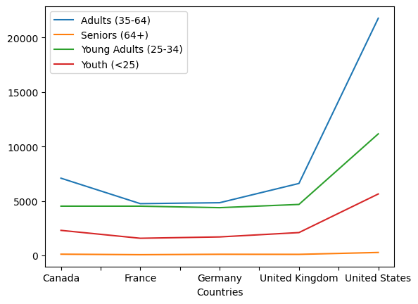
Sales Data Vs Countries

Slide 3
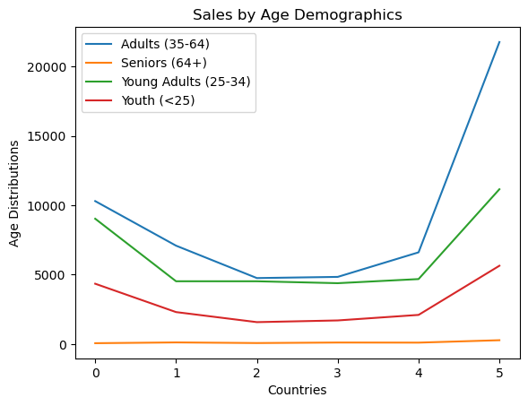
Sales by Age Demographics

